Slide 1
CITY GUIDE
“THE MASTERMINDS” TEAM MEMBERS:
Onica Rayineedi- 80
Venta Krishna– 72
Sreelekha KommaReddy – 45
Mamatha chekuti- 11

Slide 2
OBJECTIVES AND FEATURES:
This Application enables the user to retrieve the information such as places to visit, Food & restaurant availability, Events occurring, Transport facility available in that place.
After Tourist Attractions got displayed, the user can select a place from the list of attractions after which entire details such as location, contact information, and address along with select date and time attributes will get displayed
This is associated with My Schedule which allows to view his upcoming or current schedules
The user can get the notifications regarding the scheduled events
TECHNOLOGIES USED:
Code Development Tool Kit : JDK 7 , ANDROID SDK
Programming Language: JAVA
Integrated Development Environment: ANDROID STUDIO
Designing UI screens: XML
Versioning: GITHUB TOOL
Web Services: FOURSQUARE API,FACEBOOK API,GOOGLE MAPS API,MLAB

Slide 3
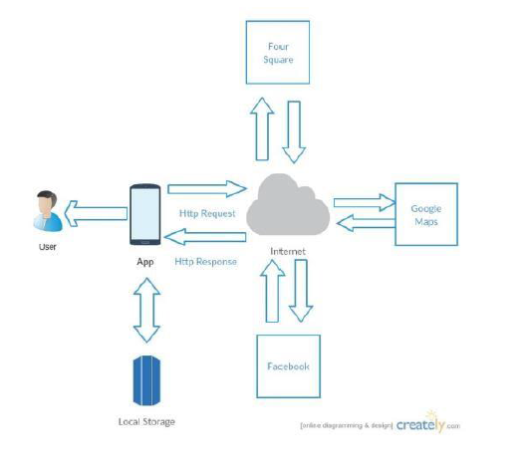
ARCHITECTURE

Slide 4
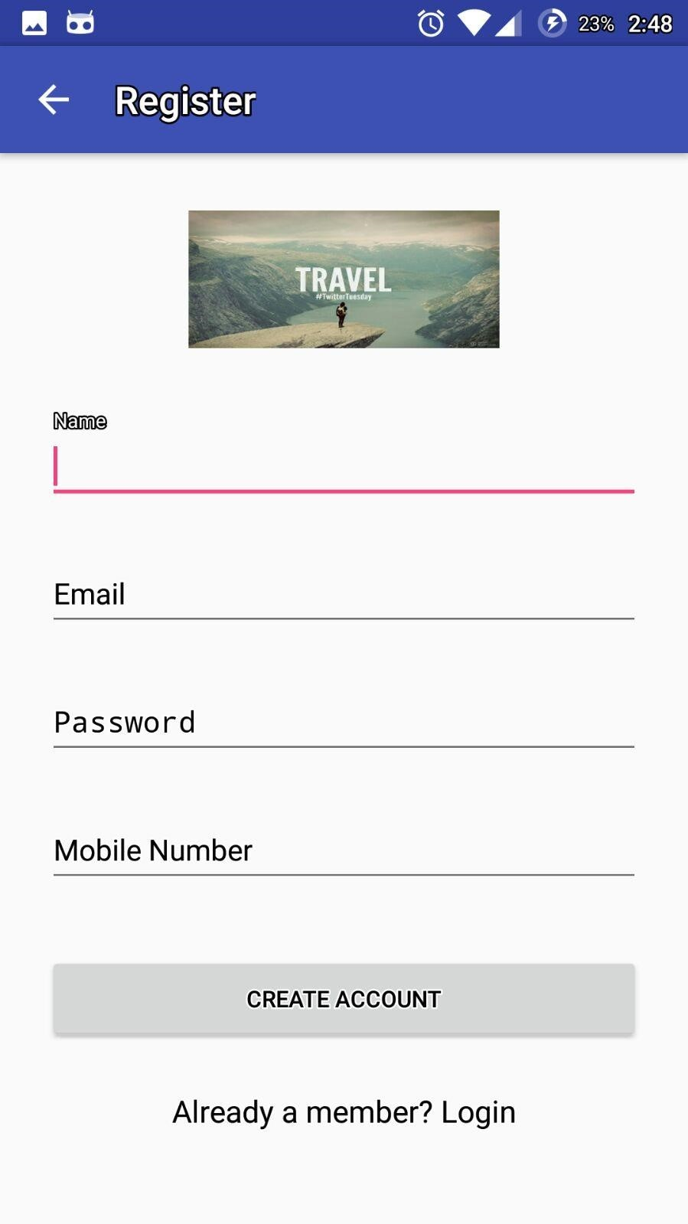
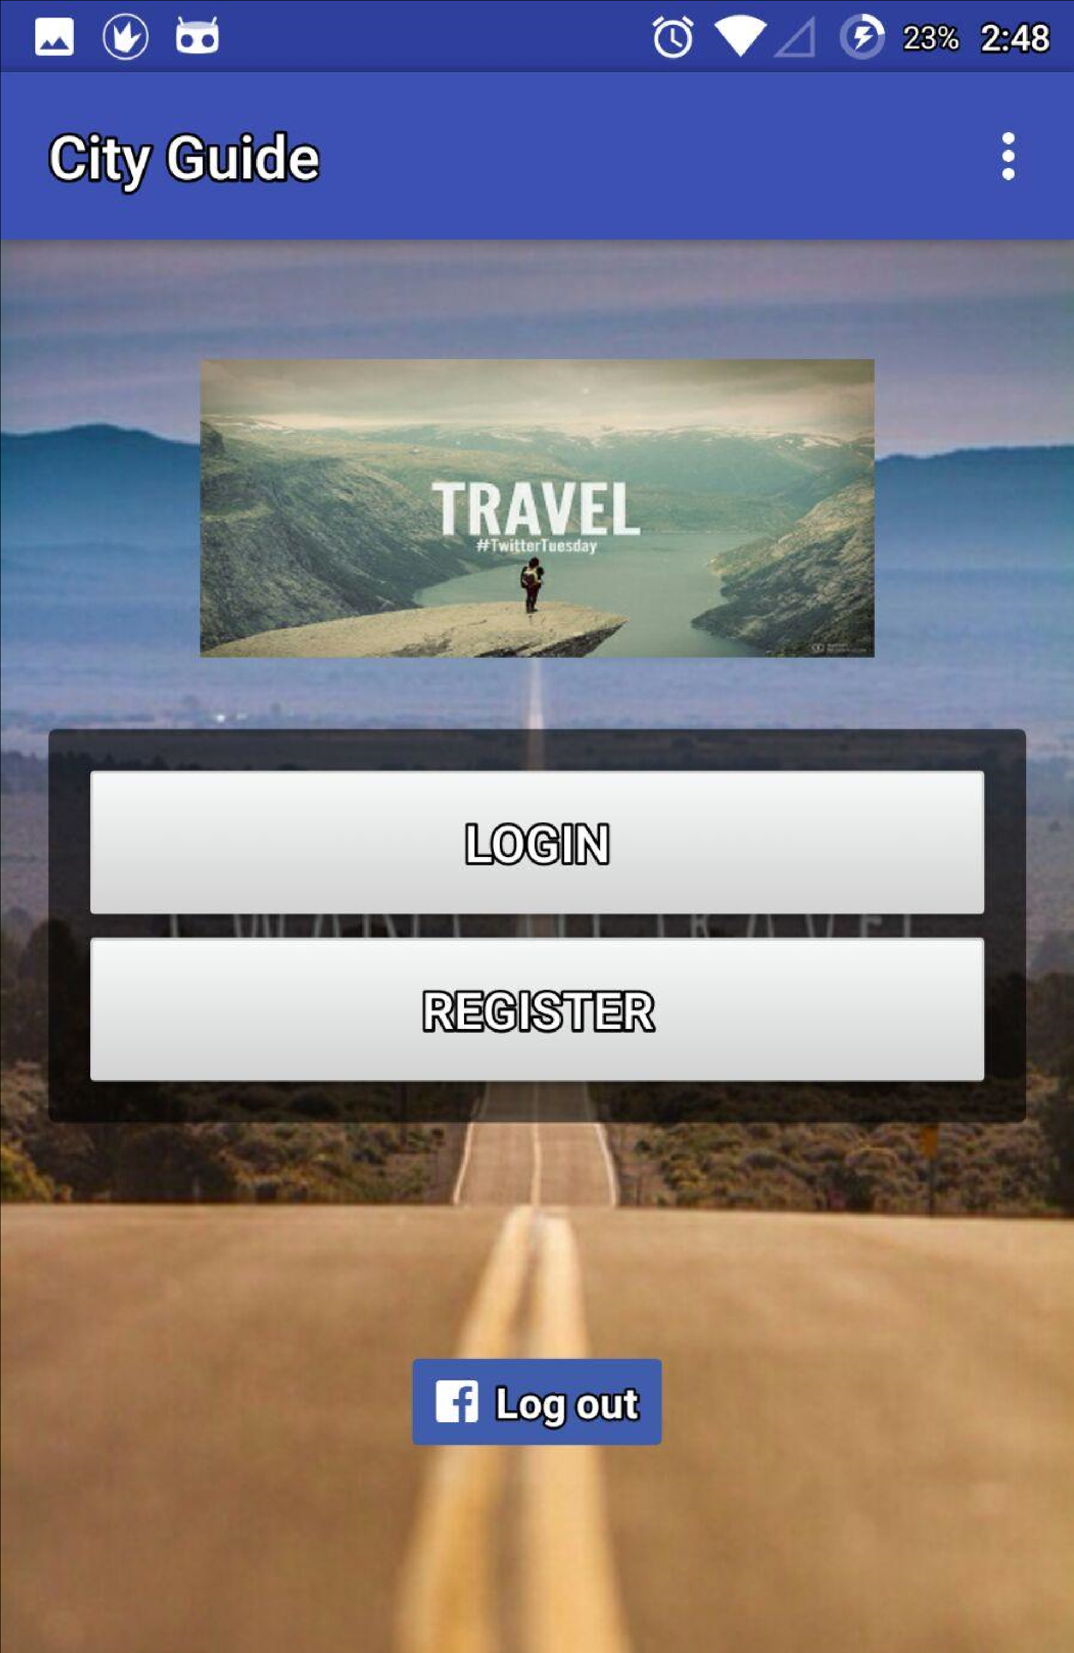
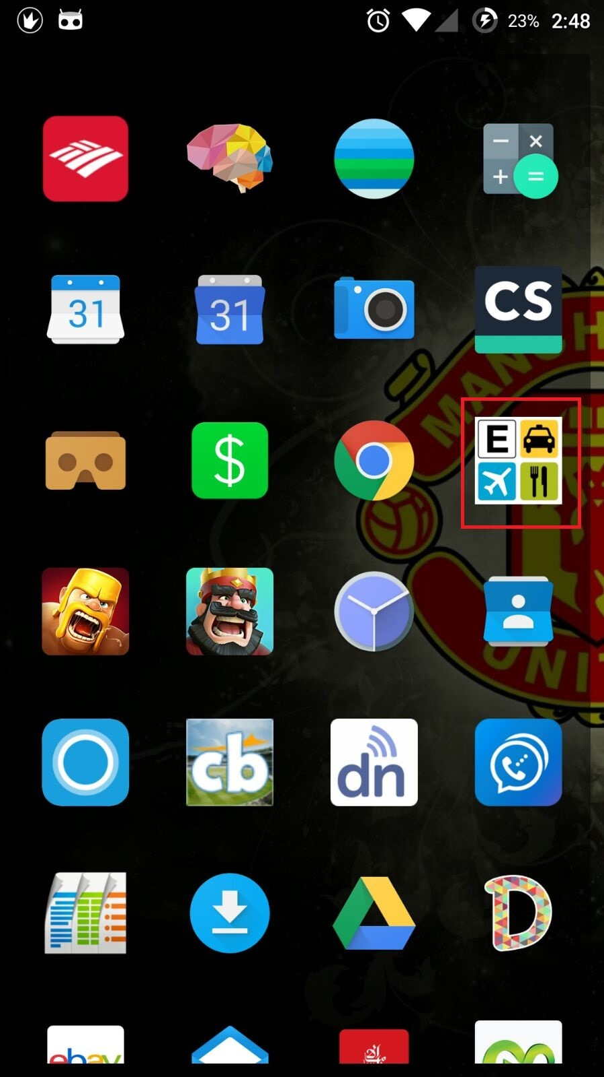
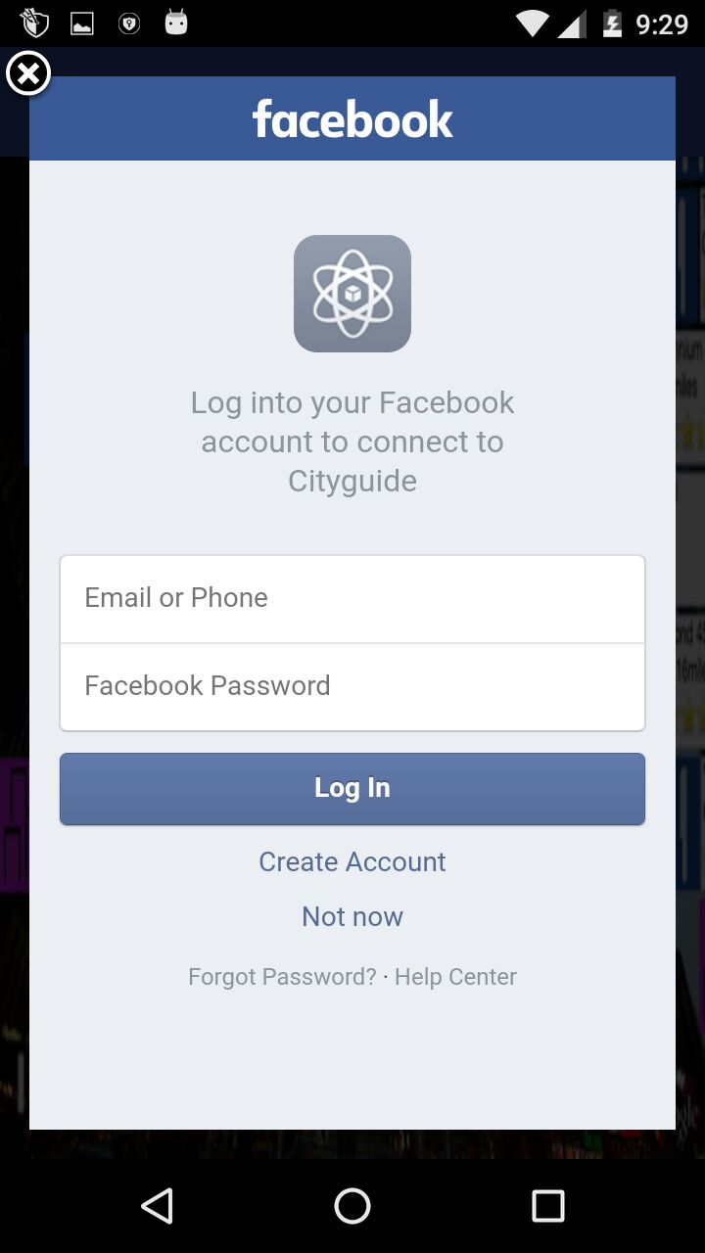
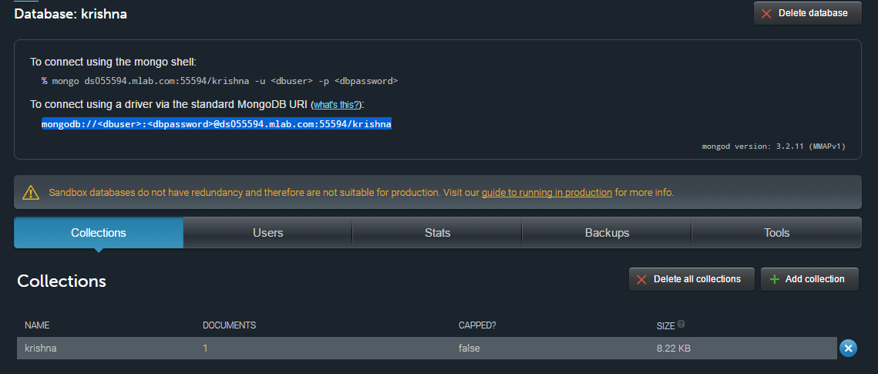
SCREENSHOTS:
1.
2.
3.
2. Main page
3.Register page
1. APP In Phone
4.
5.
5.Details stored in database
4.Login with fb

Slide 5
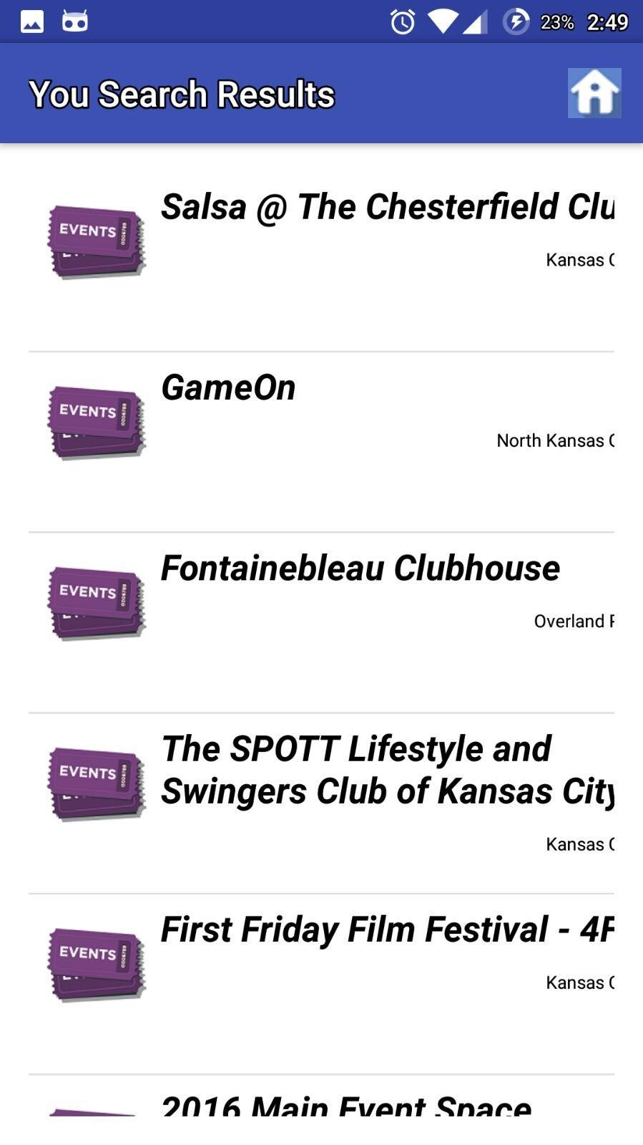
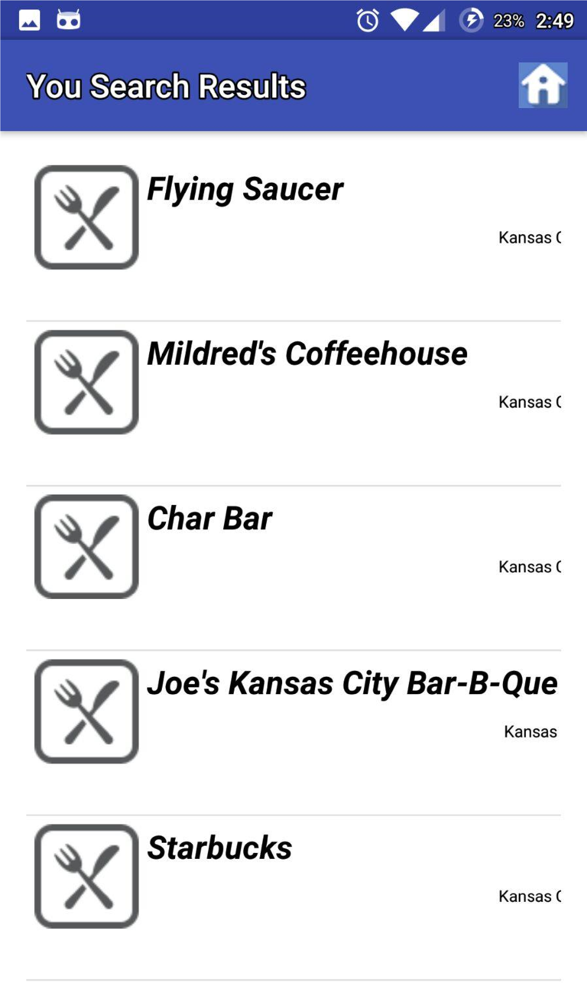
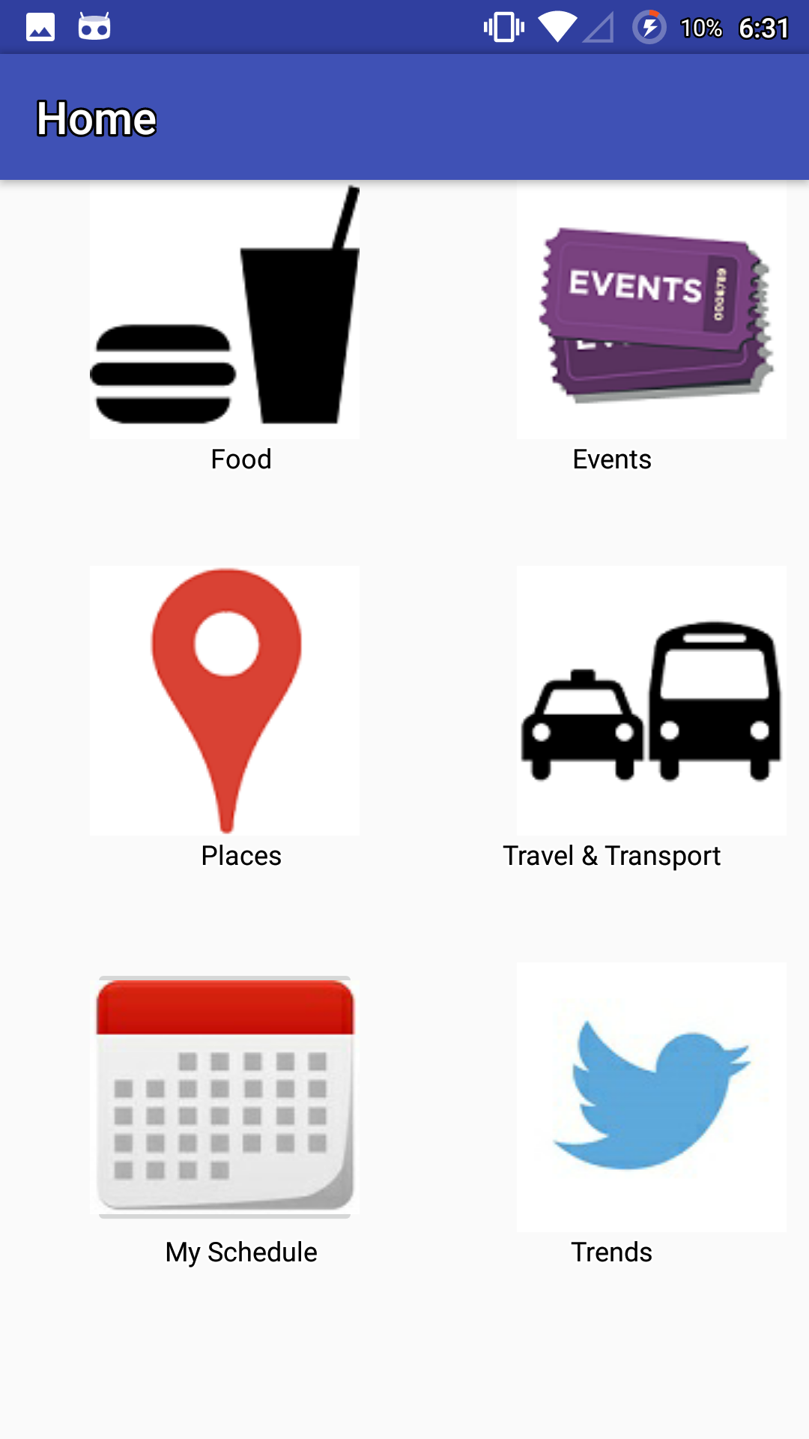
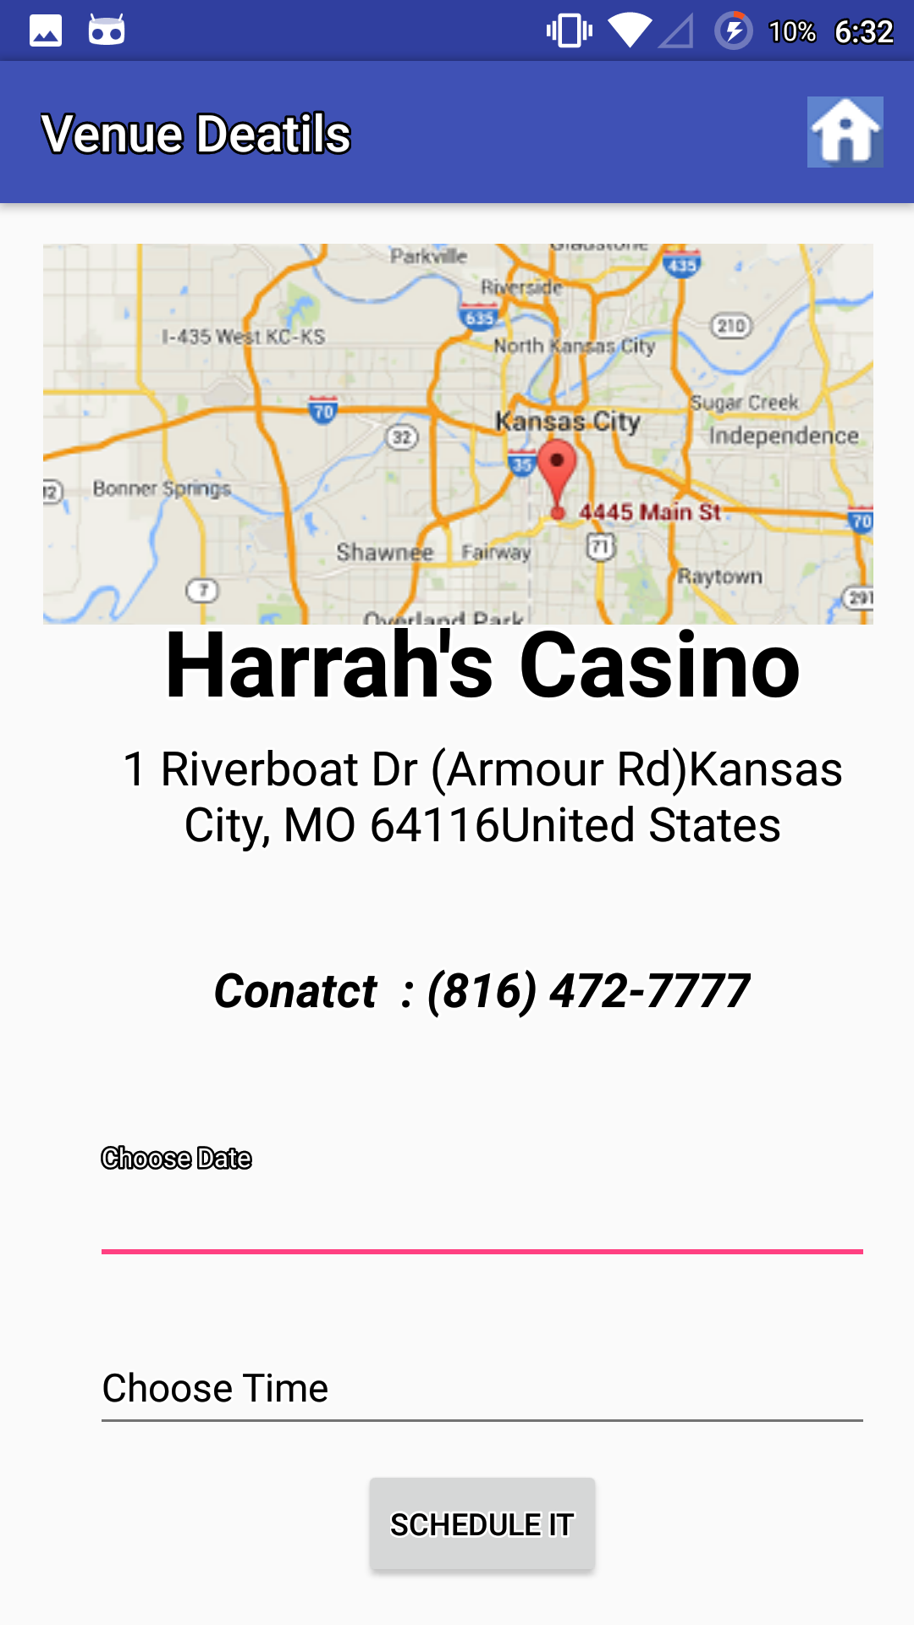
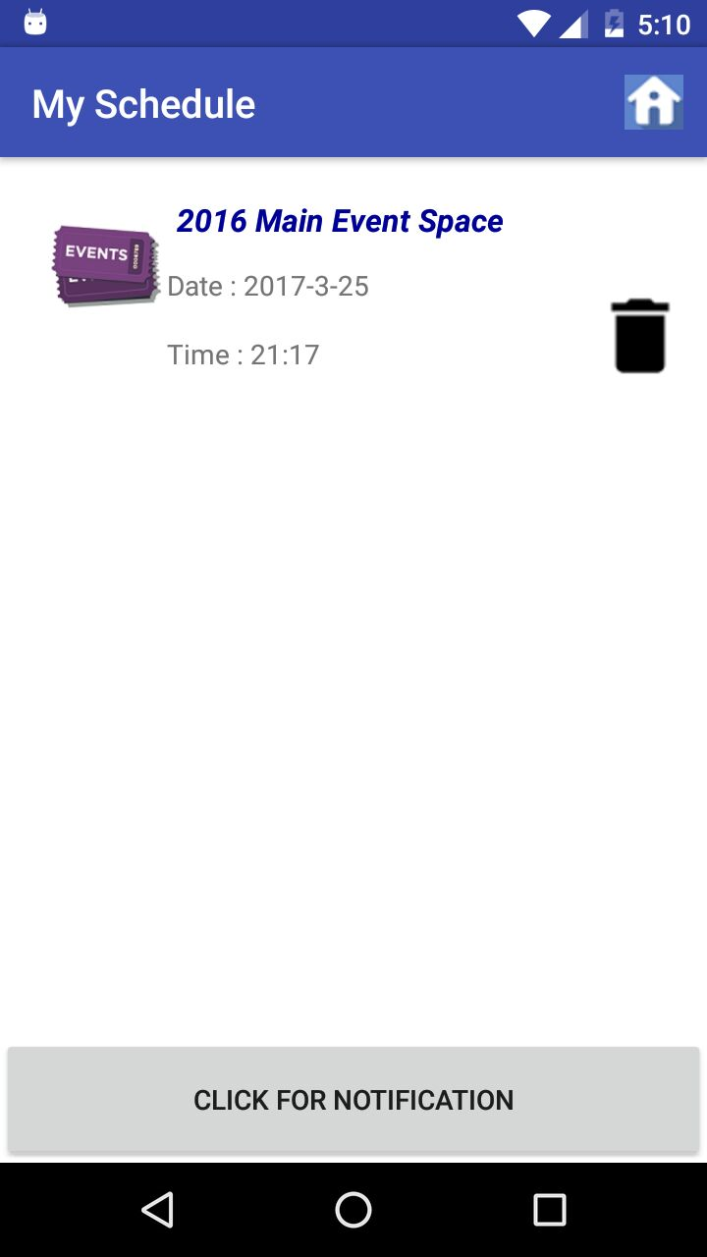
SCREENSHOTS:
1.
2.
3.
2.On Clicking events
3.On Clicking Foods
1.HOME PAGE
4.
5.
4.On Clicking “Harrah’s casino
”, details are displayed along with location.
5.Scheduling

